Slide 1

What’s New in Naviance Student
Nancy Duran • November 20, 2020

Slide 2


Naviance Student is a mobile-friendly Naviance experience that replaces Family Connection. While many of the features are familiar, it is redesigned to provide students the opportunity to engage in college and career planning more effectively and on any of their devices. It is an experience optimized for mobile devices, it is not a mobile app.

Slide 3
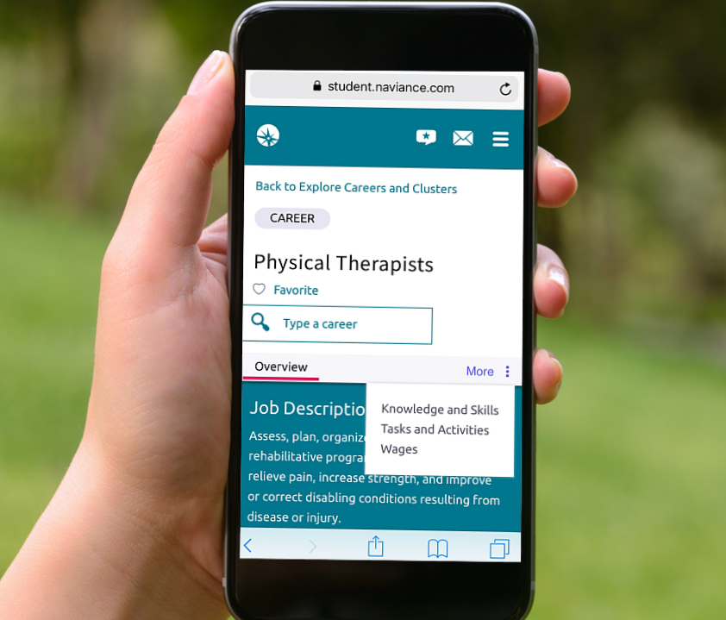
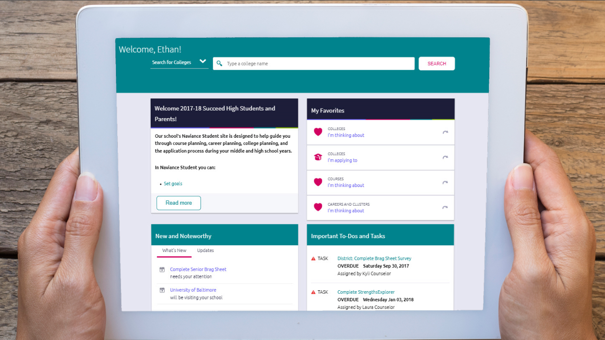
Ready to be Used on Any Device!

Slide 4

How do you access Naviance Student?
https://student.naviance.com/schoolalias
Log in with your previously assigned username/password
To access on your device, do the same thing via your device’s browser

Slide 5
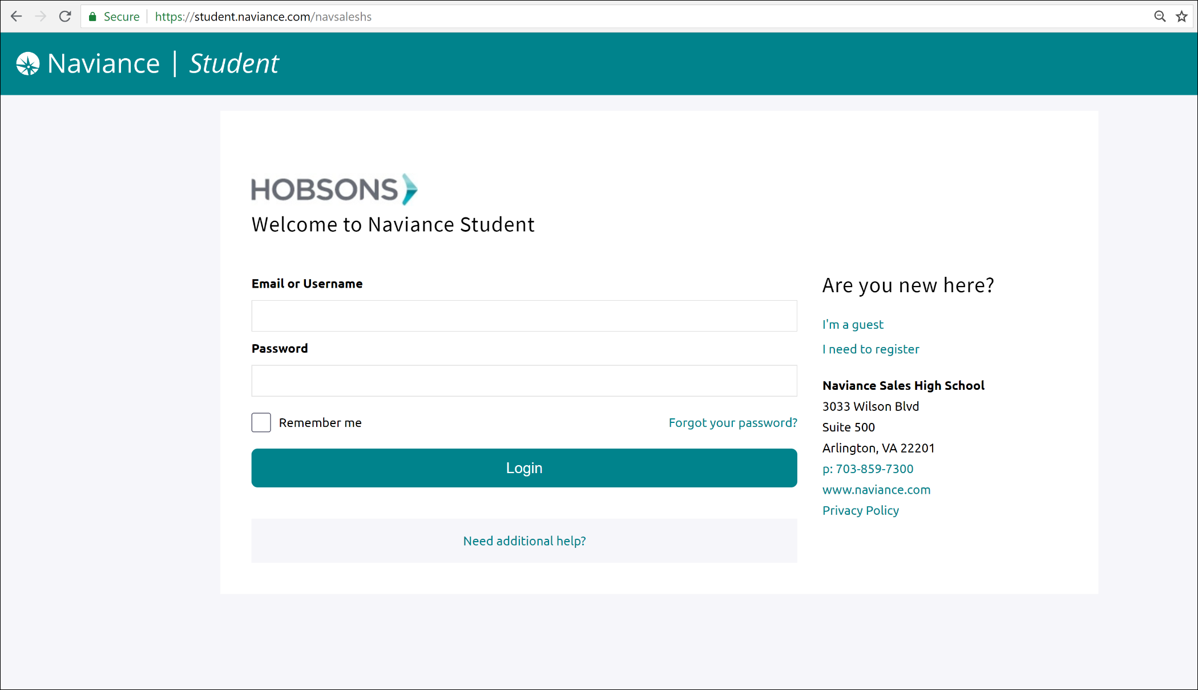

Slide 6
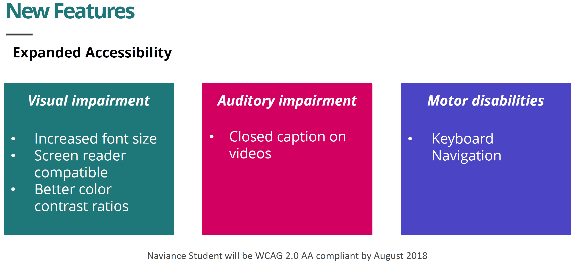

Slide 7
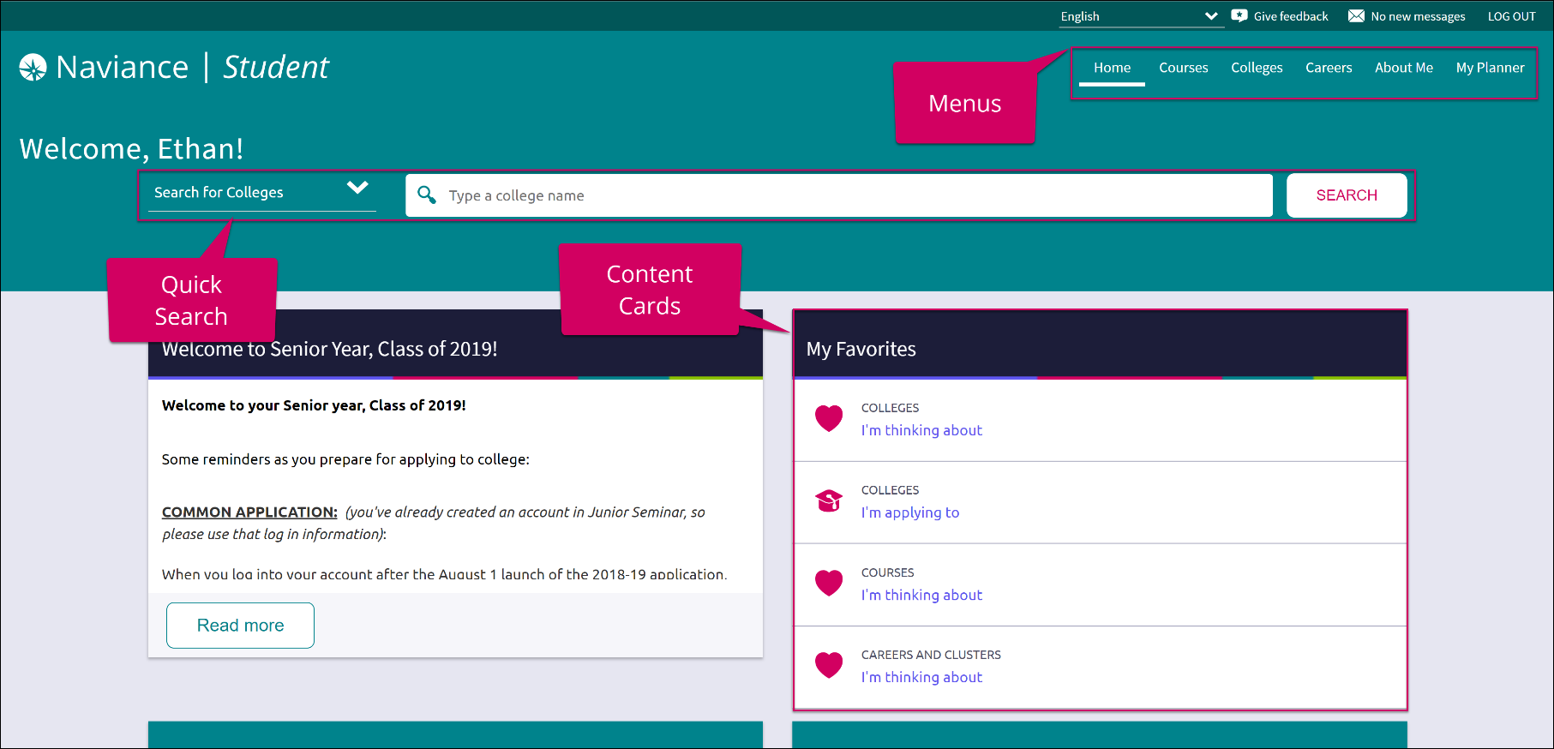
How do I navigate Naviance Student?
Content Cards
Menu Navigation
Quick Search
Content cards provide the framework for a mobile-friendly design.
With no tabs in sight, Naviance Student is modernized with menu navigation, making all of the features easy to find.
Use Quick Search to quickly locate colleges and careers of interest without navigating to the related menus.

Slide 8
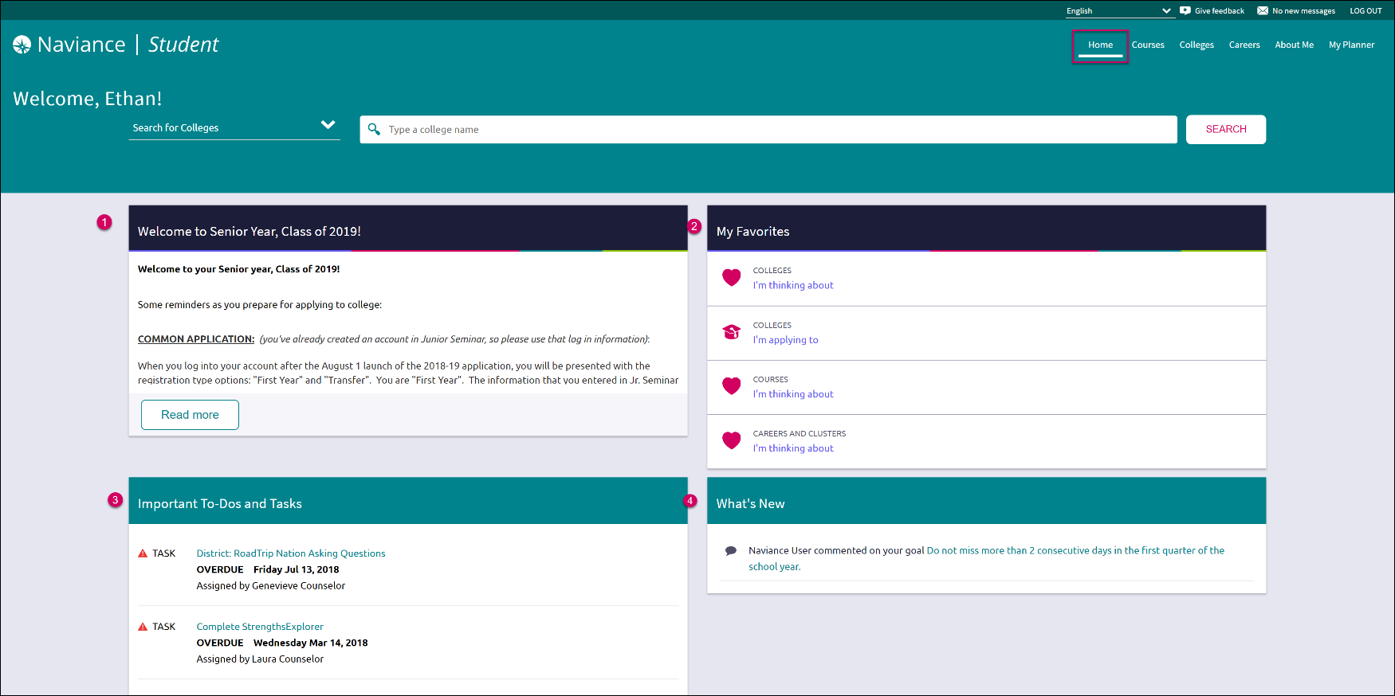
Home Page
Welcome Message: Look for important school-related messages.
My Favorites: Easily access lists of the colleges, courses, and careers you’ve favorited.
Important To-Dos and Tasks: Get easy access to upcoming or overdue To-Dos and Tasks.
What’s New: Search for and keep track of scholarships.

Slide 9
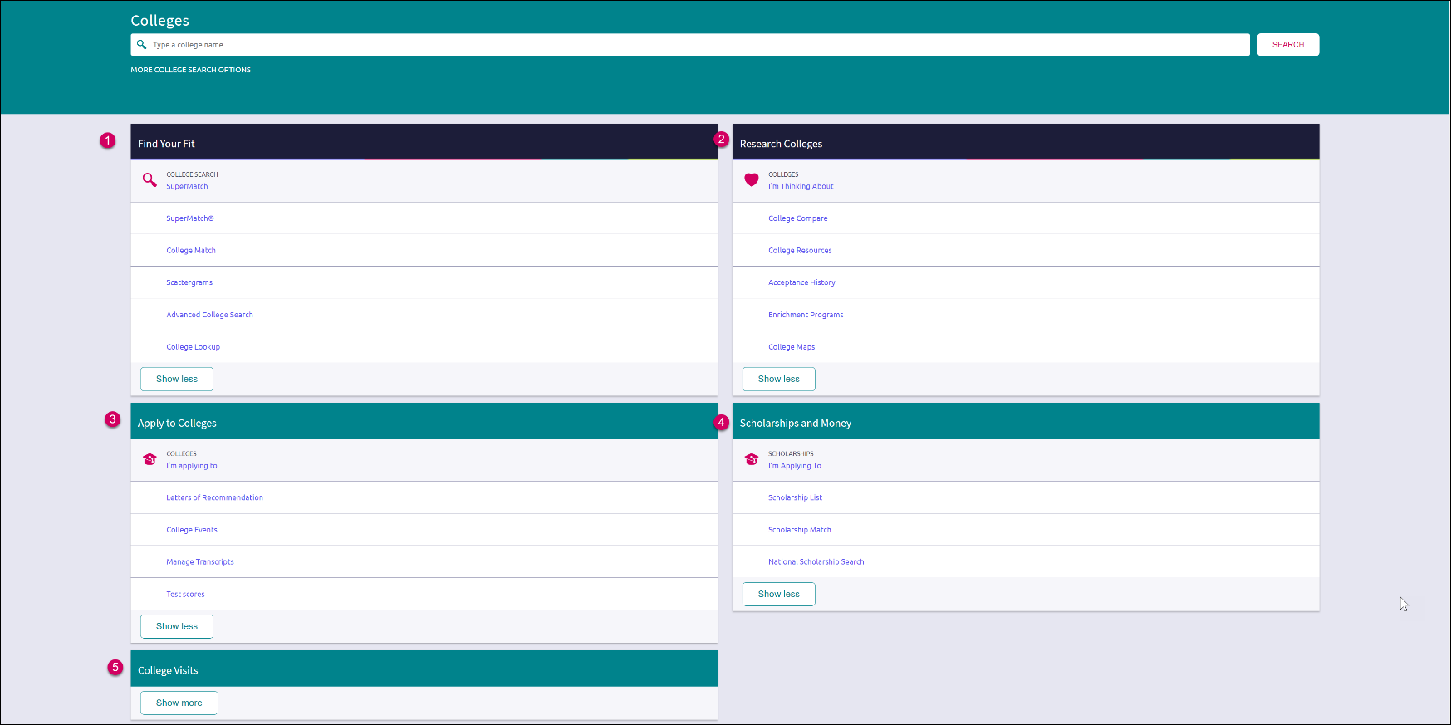
Colleges
Page
Find Your Fit: Use tools like SuperMatch and Scattergrams to identify your best-fit college.
Research Colleges: Dig deeper into colleges of interest using tools like Acceptance History.
Apply to Colleges: Manage college applications and corresponding documentation.
Scholarships & Money: Search for and keep track of scholarships.
College Visits: Check out and sign up for colleges visiting the school.

Slide 10
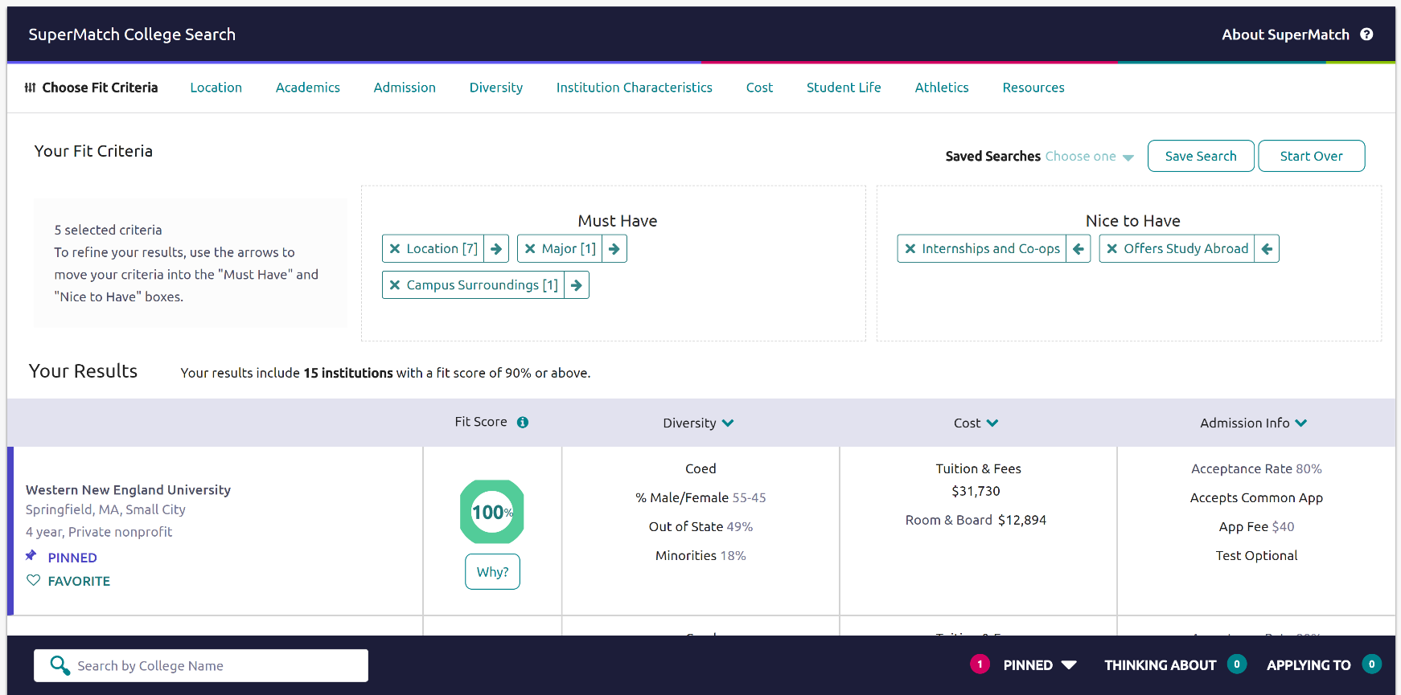
New and Improved SuperMatch
Tooltips guide you through searching over 20 new filters to find your best-fit institution.
See WHY a College got a Certain Fit Score.
Pin and Favorite Colleges of Interest
Compare your Pinned Colleges

Slide 11

New and Improved SuperMatch
Hover and click to play the video

Slide 12
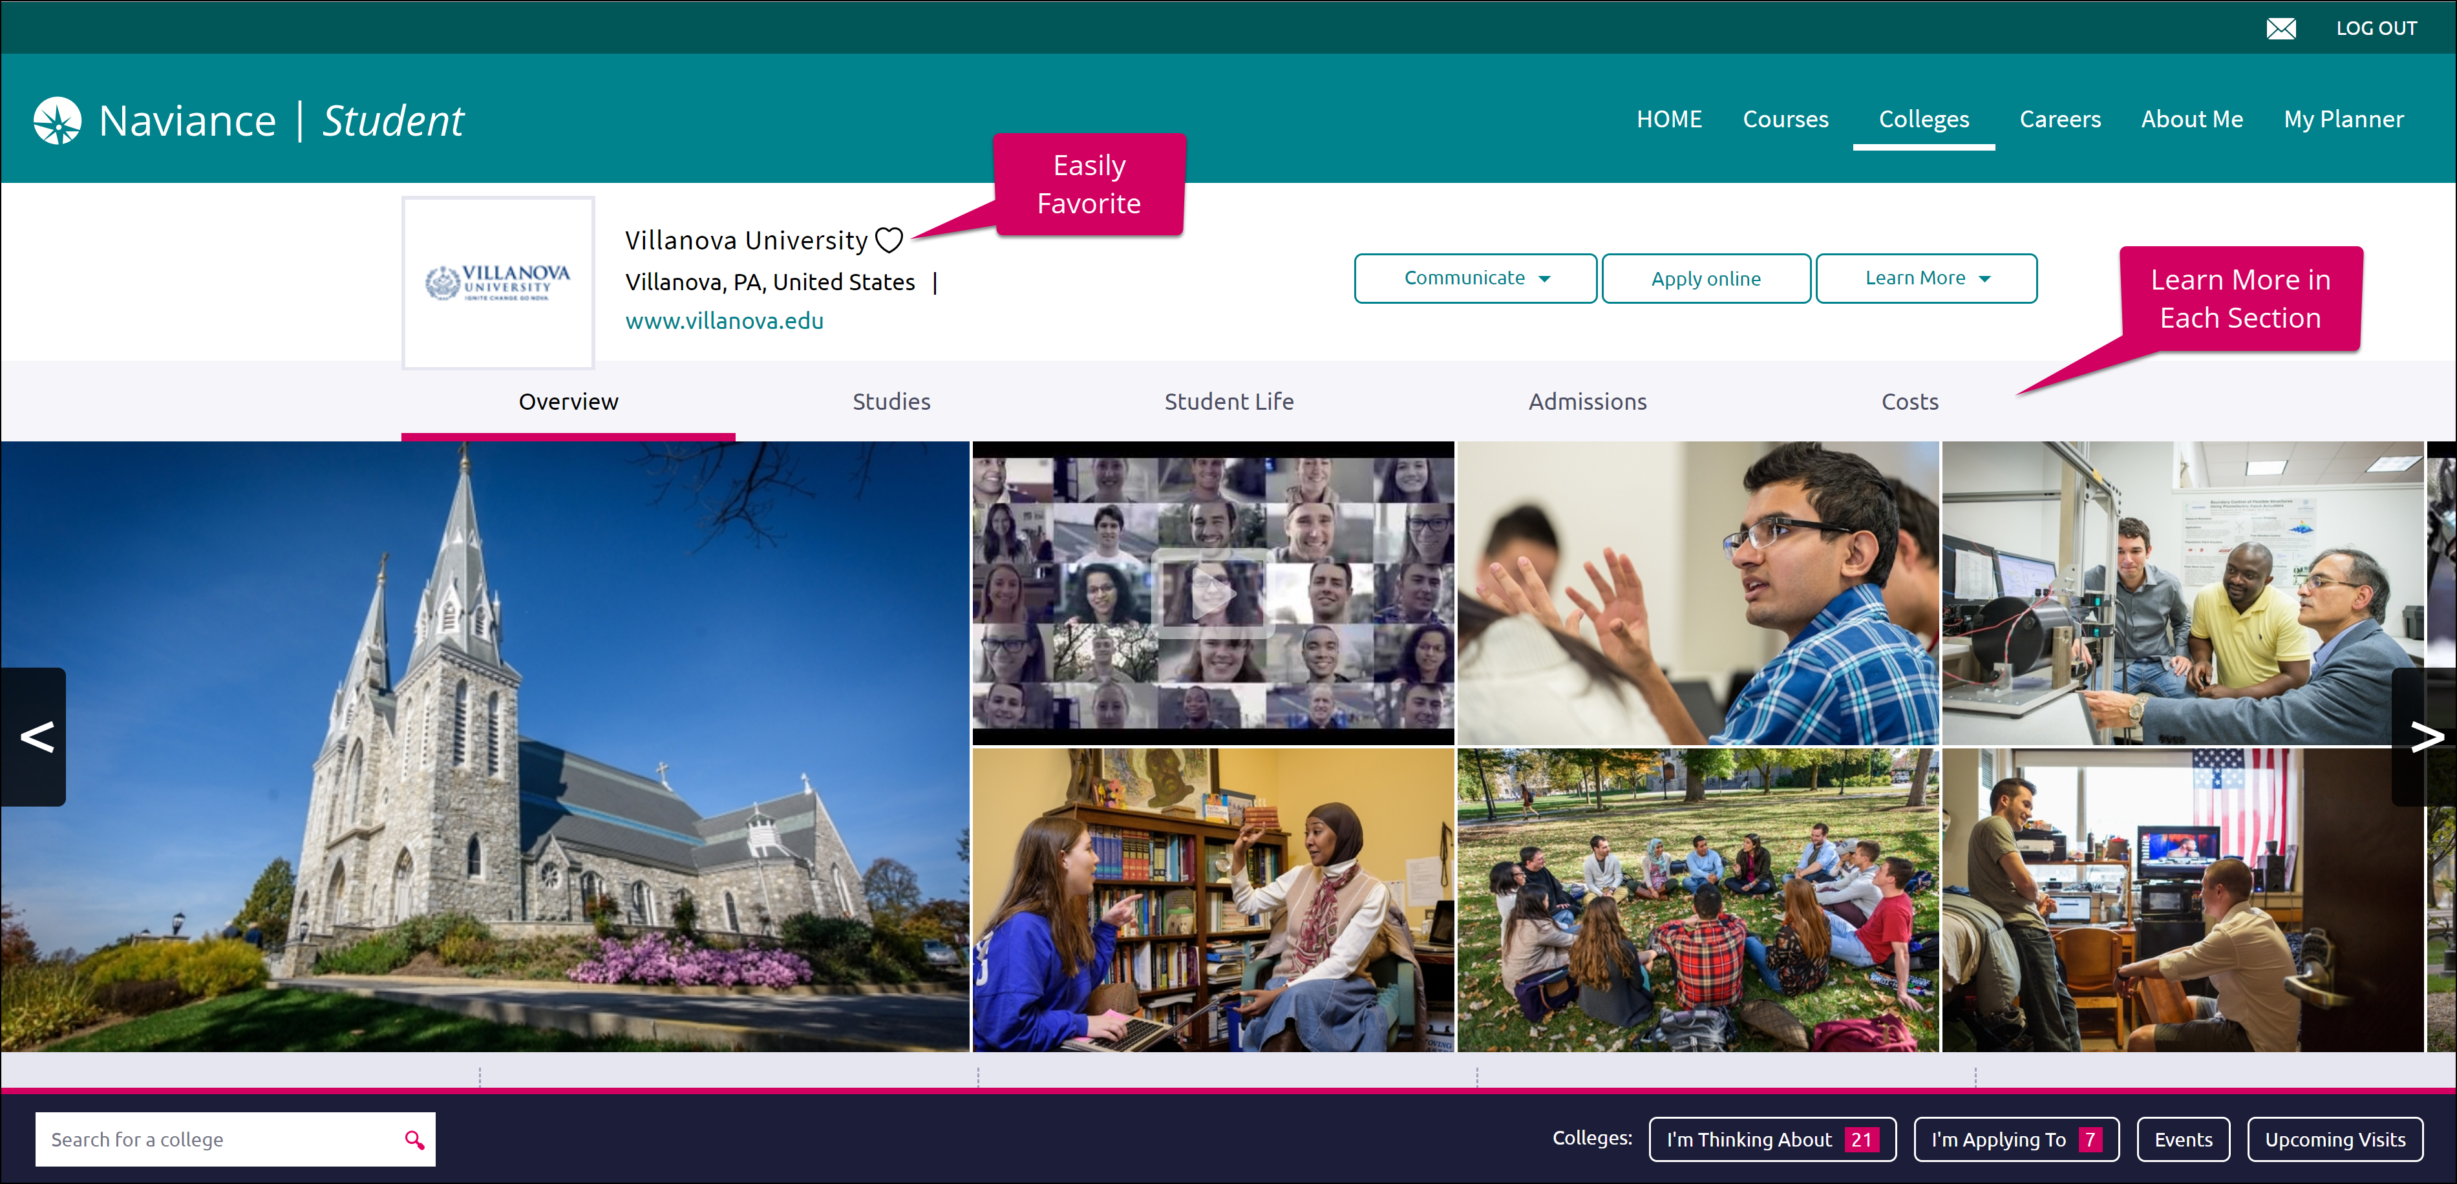
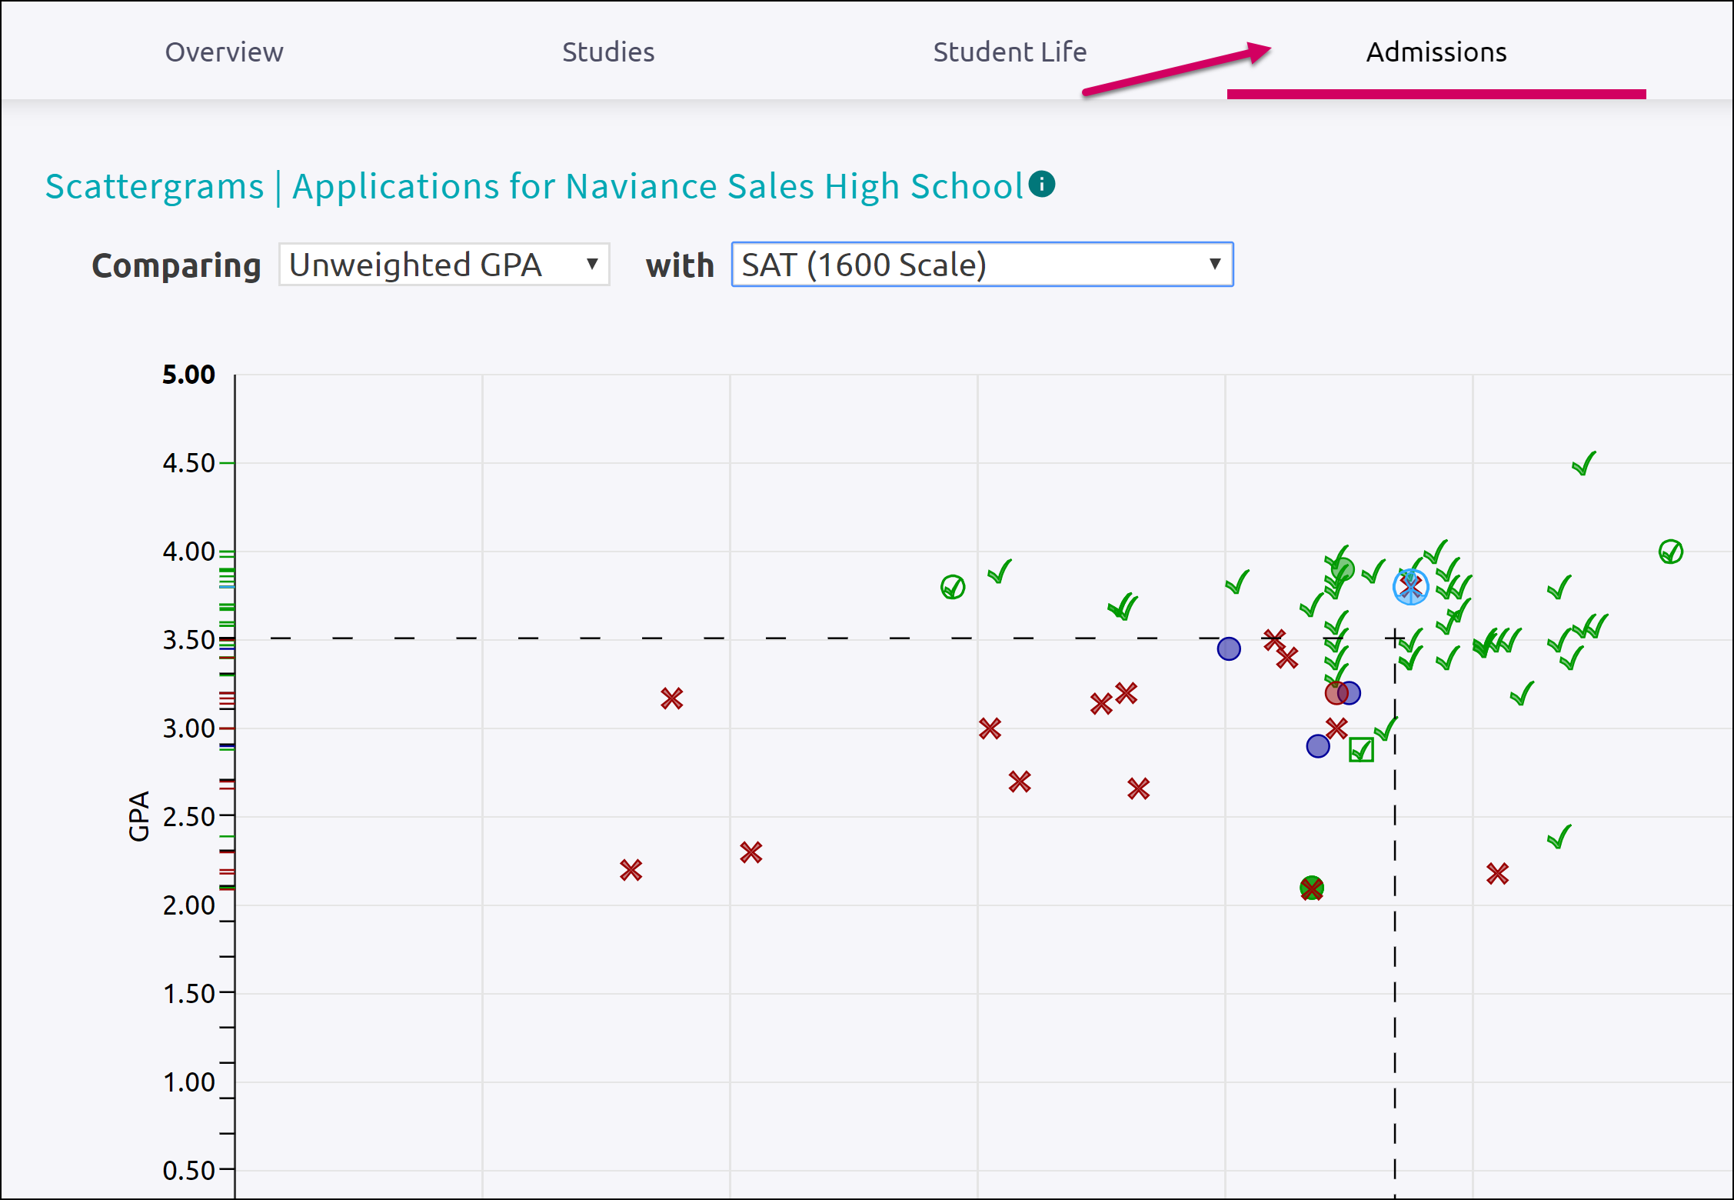
Get a lot of great information, including info about student life, admissions, and costs!
College Profiles
Check out Scattergrams for this college using the Admissions tab

Slide 13
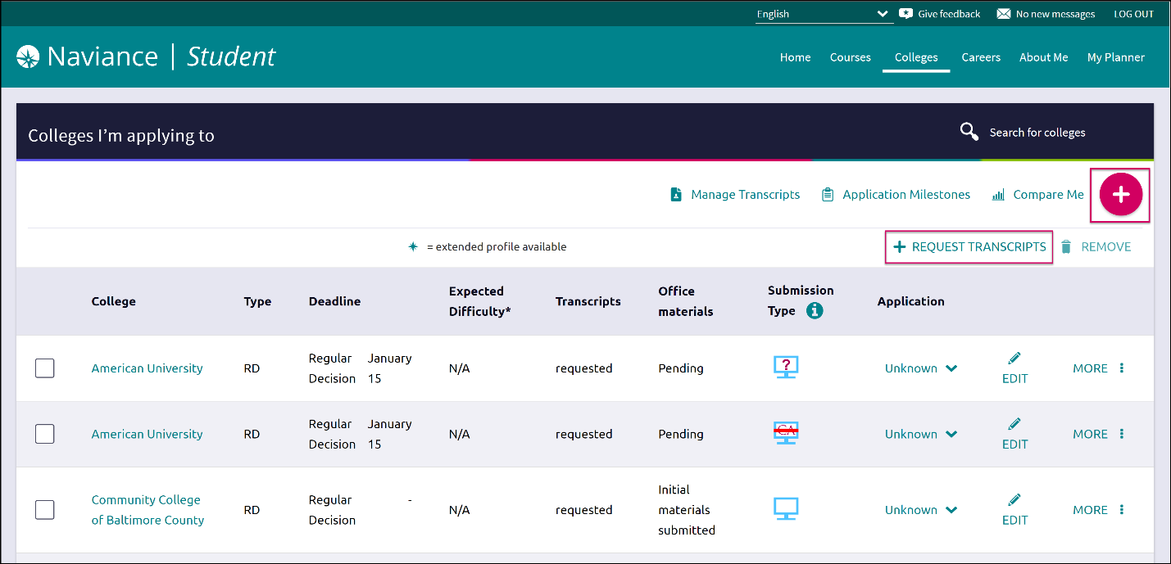
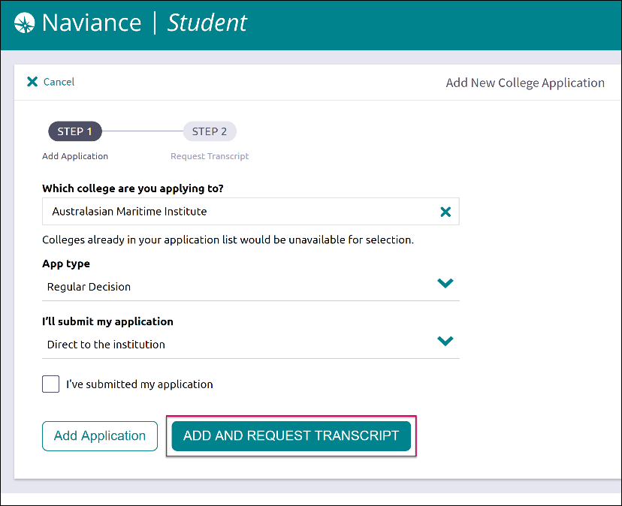
Request Transcripts
In order to access a transcript request, open the Colleges I’m Applying To list
Option 1: When using the plus (+) to add a new college, you can request a transcript during the process.
Option 2: The Request Transcripts option allows you to request a transcript for any of the colleges on your list.

Slide 14
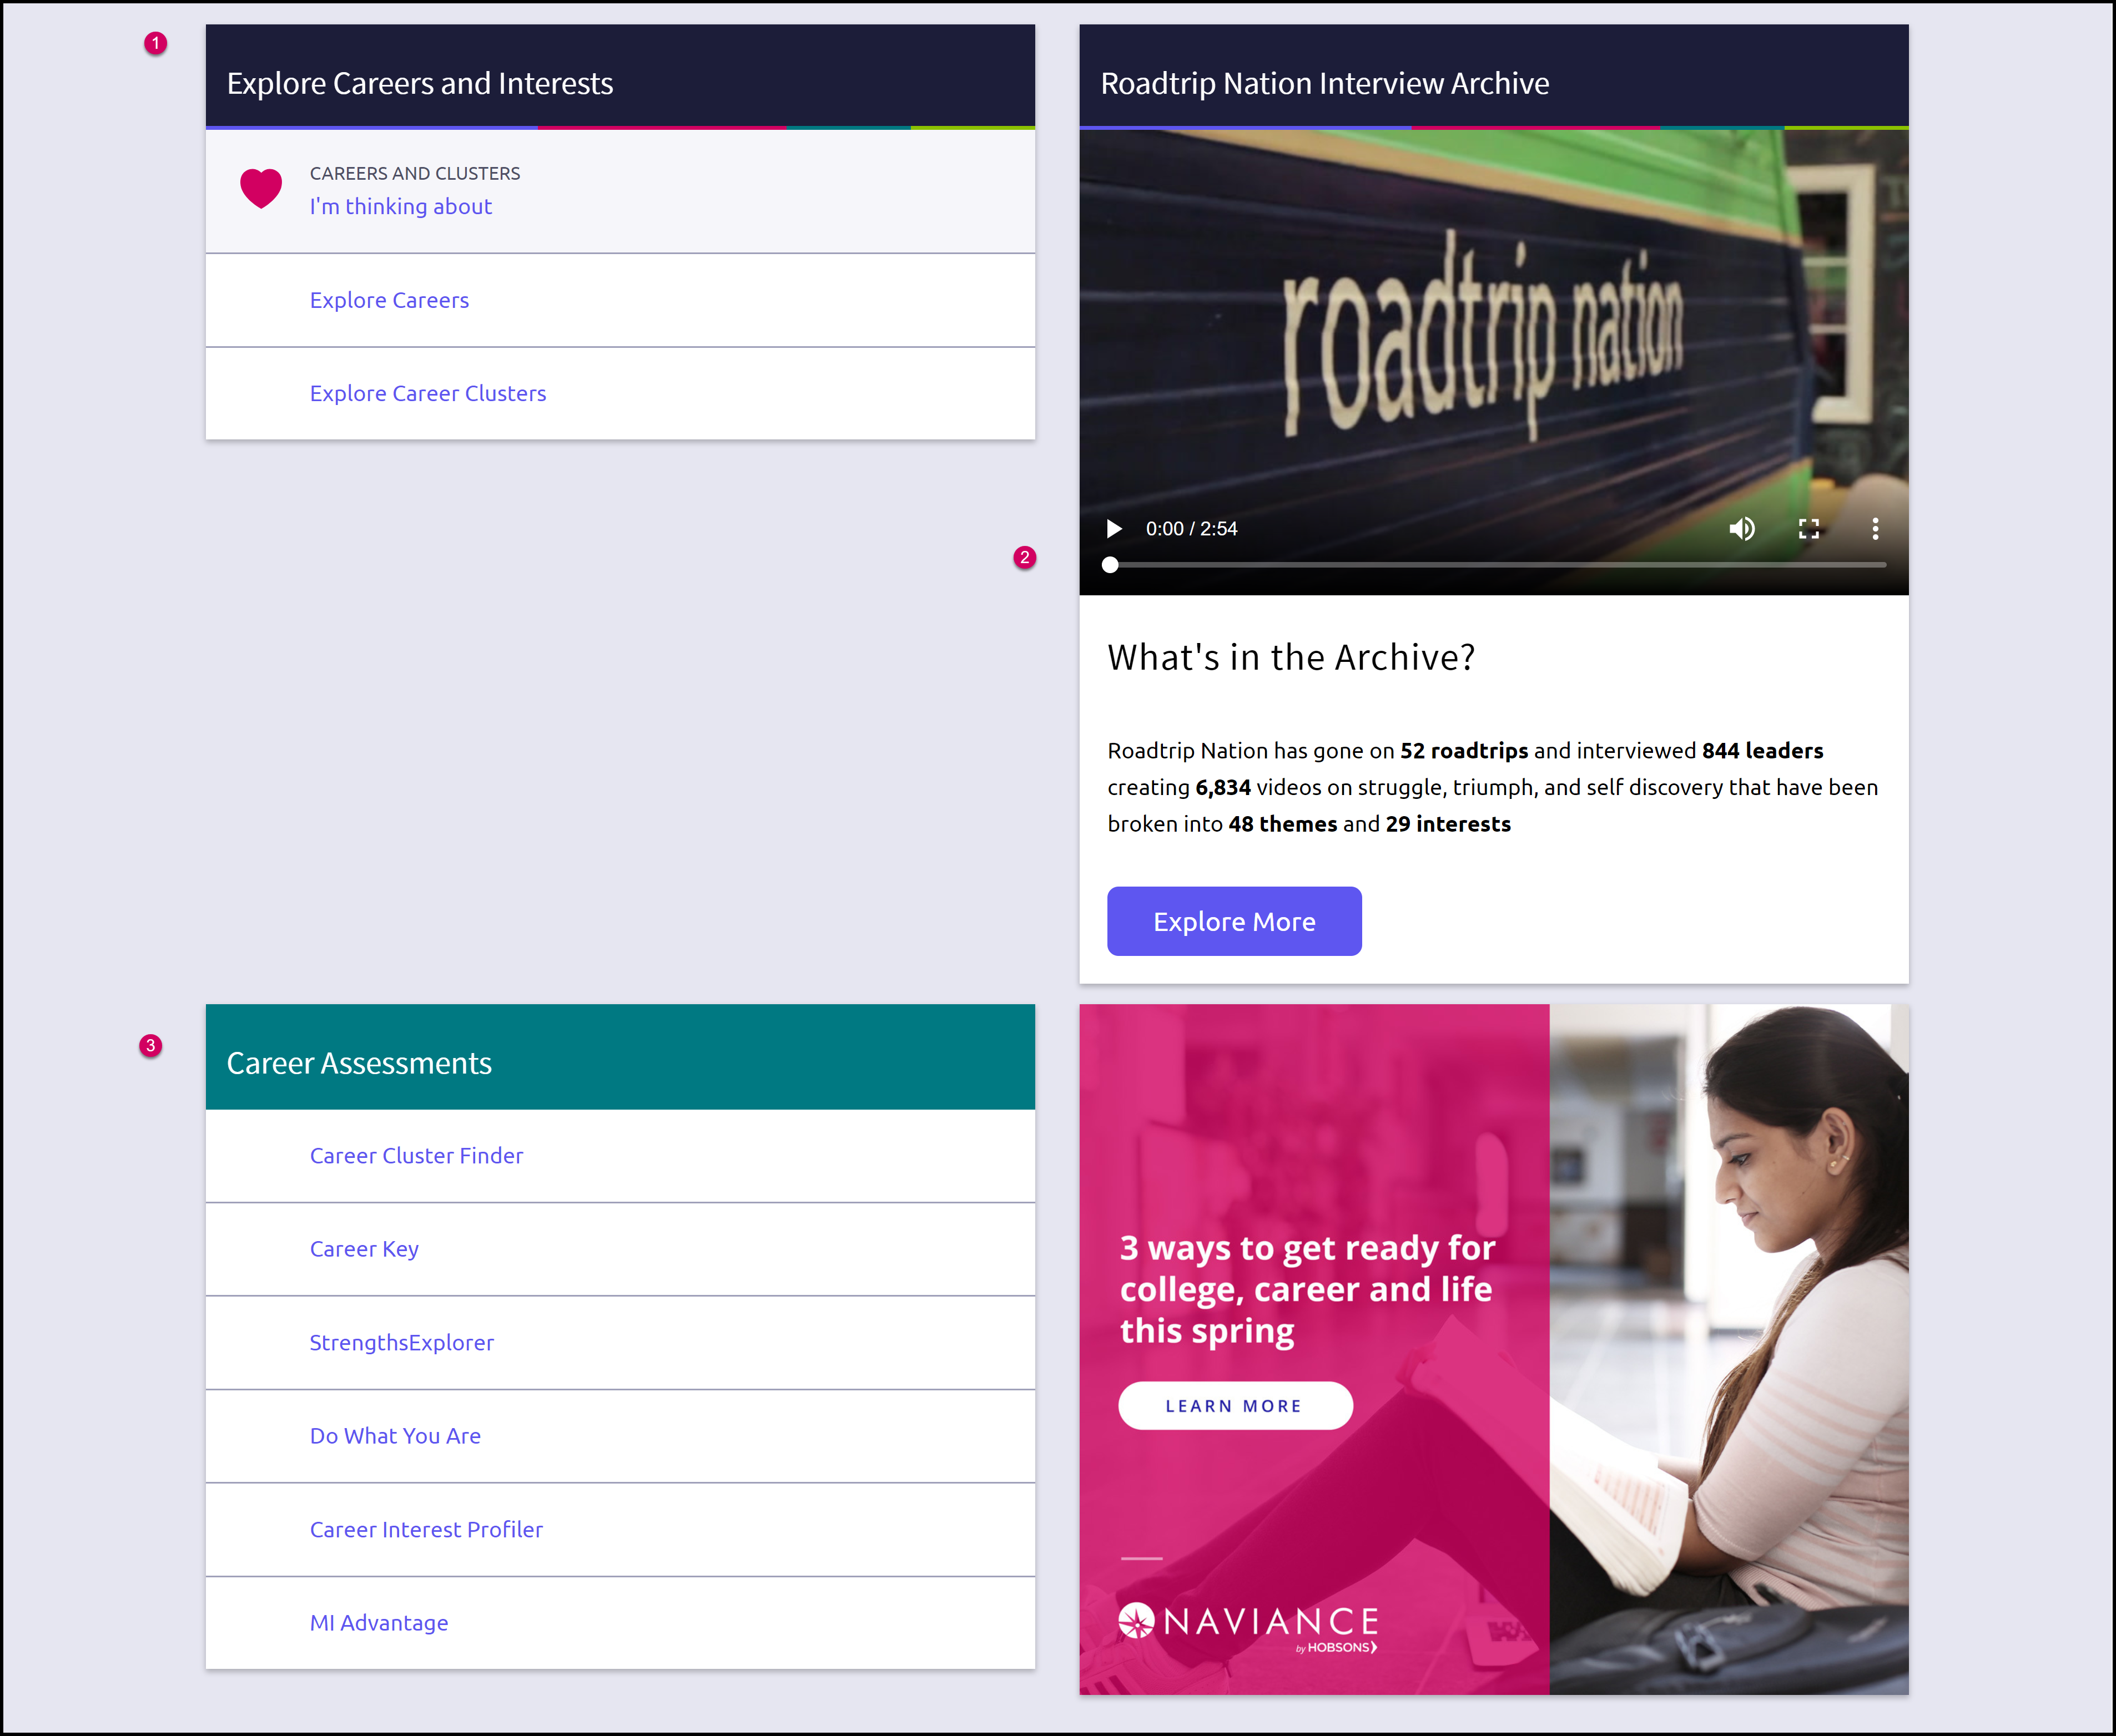
Careers
Page
Explore Careers and Interests: Participate in career-related assessments and view your favorite careers and clusters.
Roadtrip Nation Interview Archive: Access over 5,000 videos that focus on various interests and themes related to careers.
Career Assessments: View and take all accessible assessments to tell you more about yourself and your interests.

Slide 15
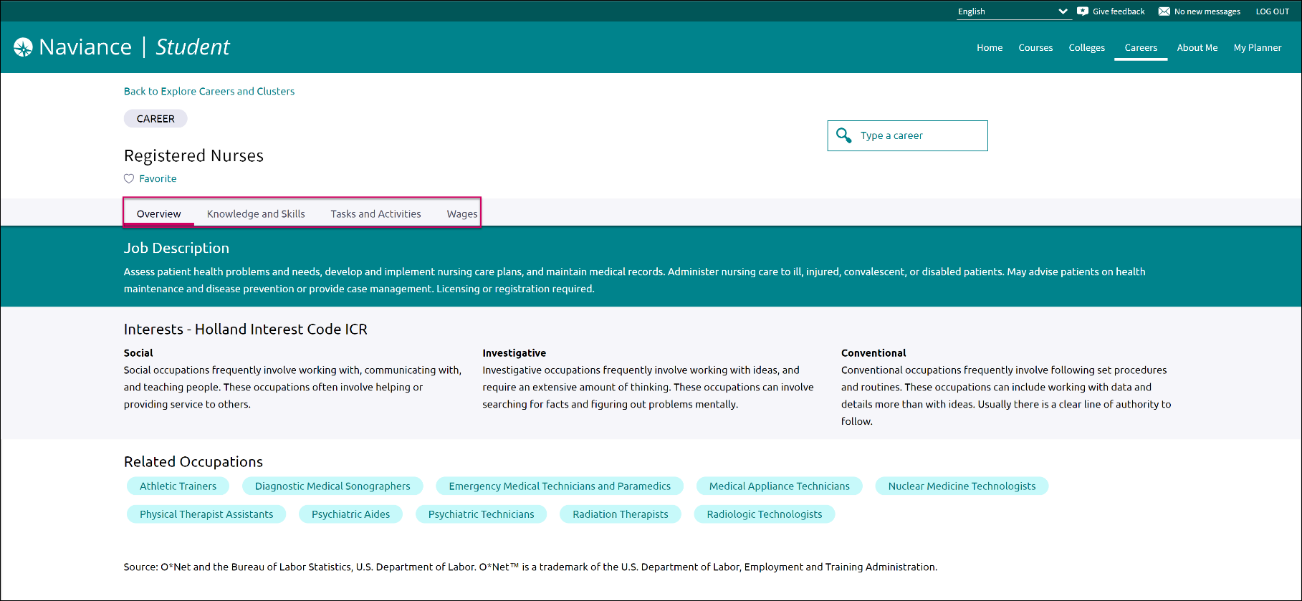
Enhanced Career Pages
Enhanced career pages provide access to information on knowledge and skills, tasks and activities, and wages related to a specific career.

Slide 16
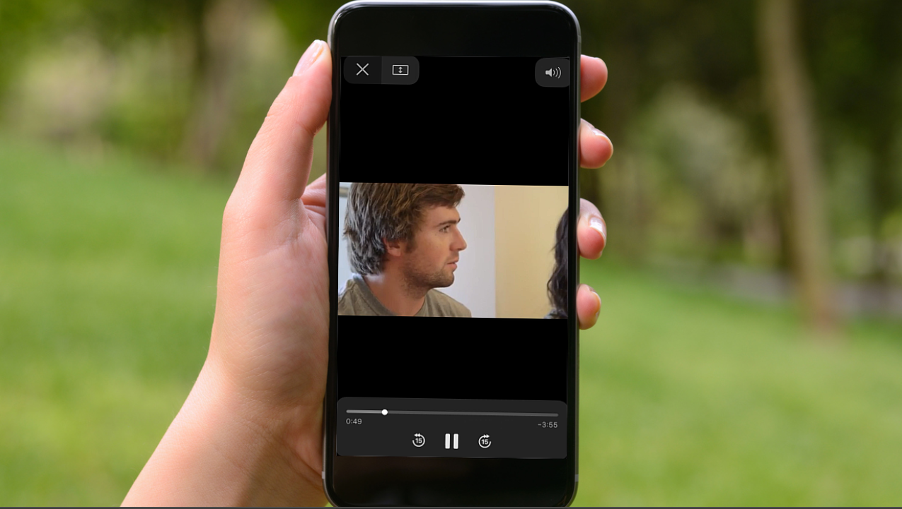
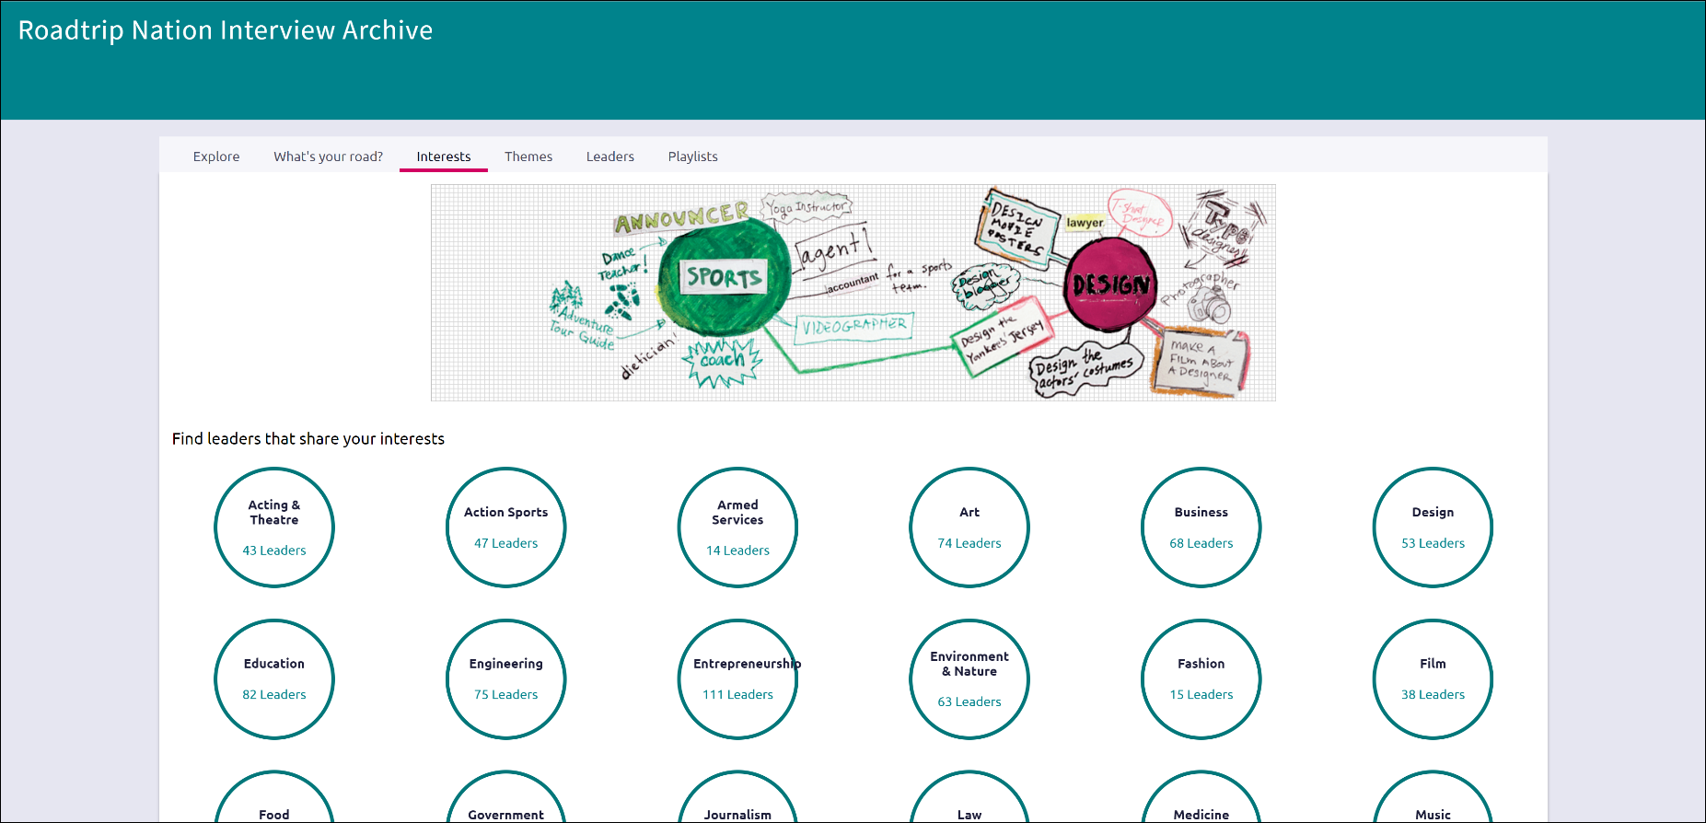
RTN Videos are Now Mobile-Compatible
After you’ve found videos of interest, you can watch them on any of your devices!

Slide 17
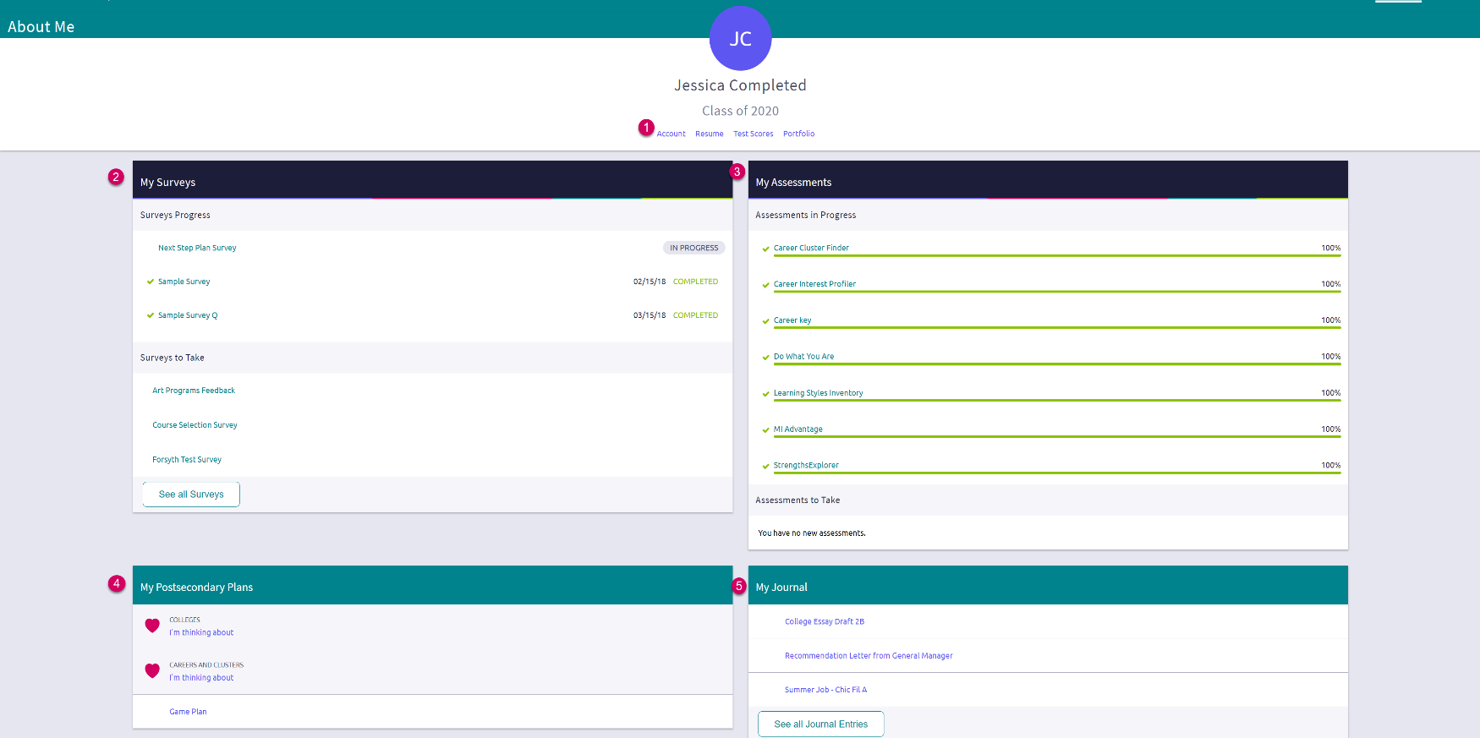
About Me Page
Accounts, Resumes, Test Scores & Portfolio: Quickly access these areas related to your info.
My Surveys: See your surveys in progress, their status, and ones that still need to be completed.
My Assessments: See assessments in progress, a % completed, and any you still need to take.
My Postsecondary Plans: Gain quick access to favorite colleges & careers, and the Game Plan.
My Journal: View your most recent journal entries or click to see all of them.

Slide 18
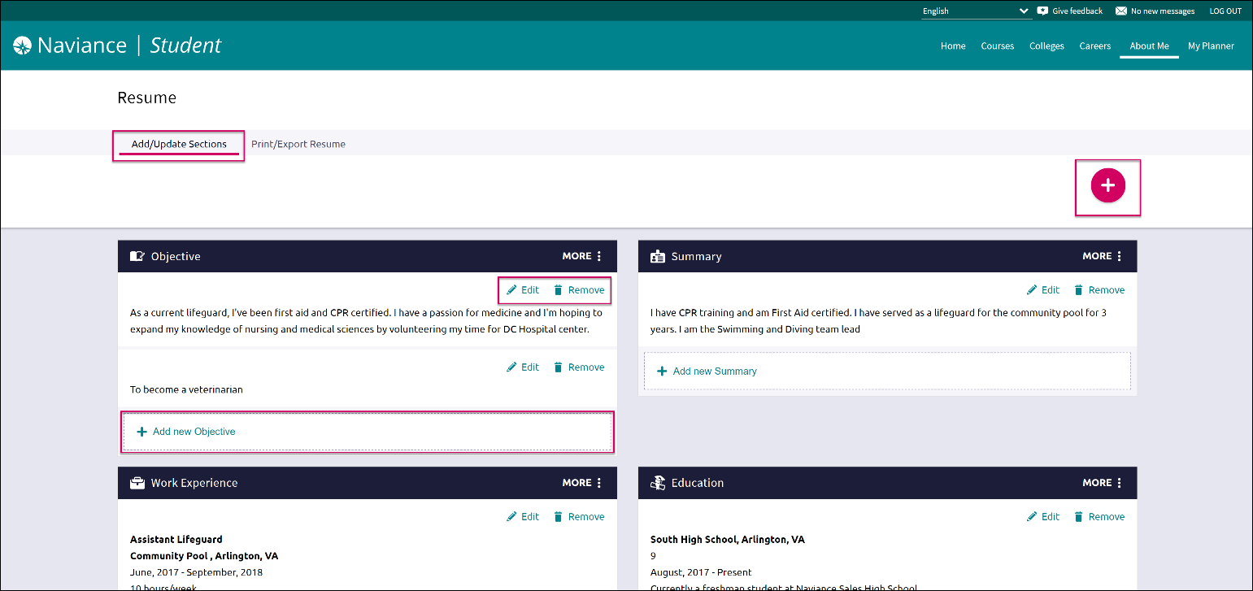
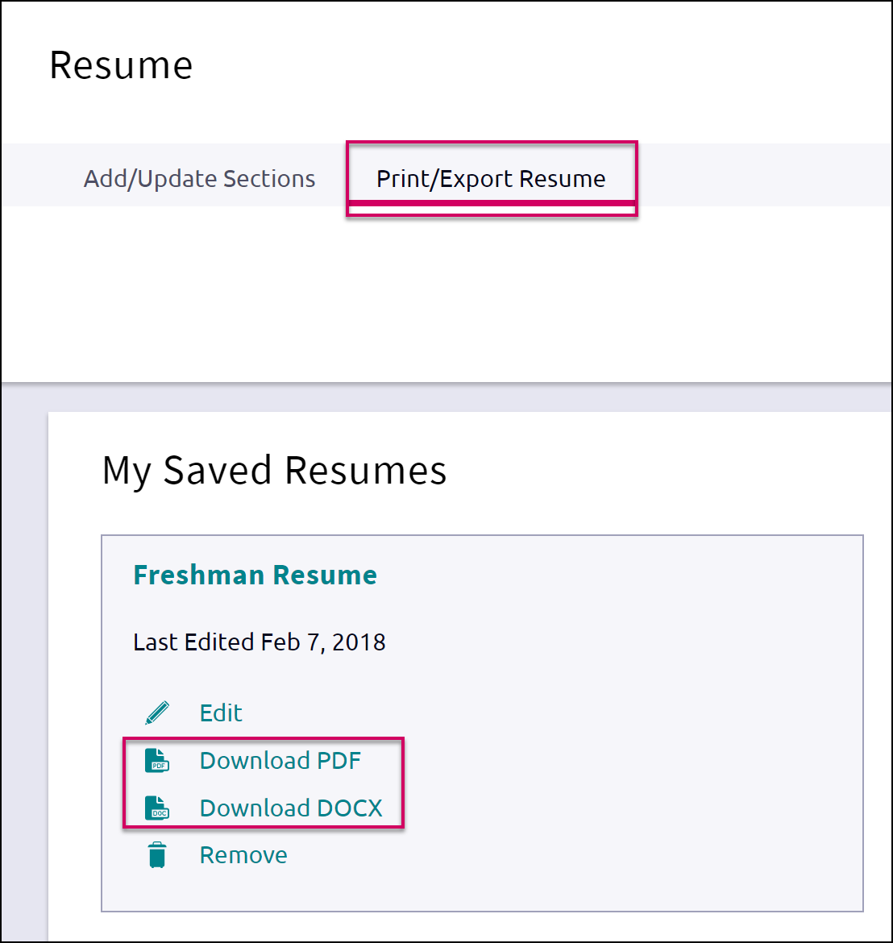
New Resume Builder and Exporting Tools
Step 1: Add or Update Sections (Pink Plus to Add)
Step 2: Use the Download PDF or Download DOCX to edit or share the resume

Slide 19
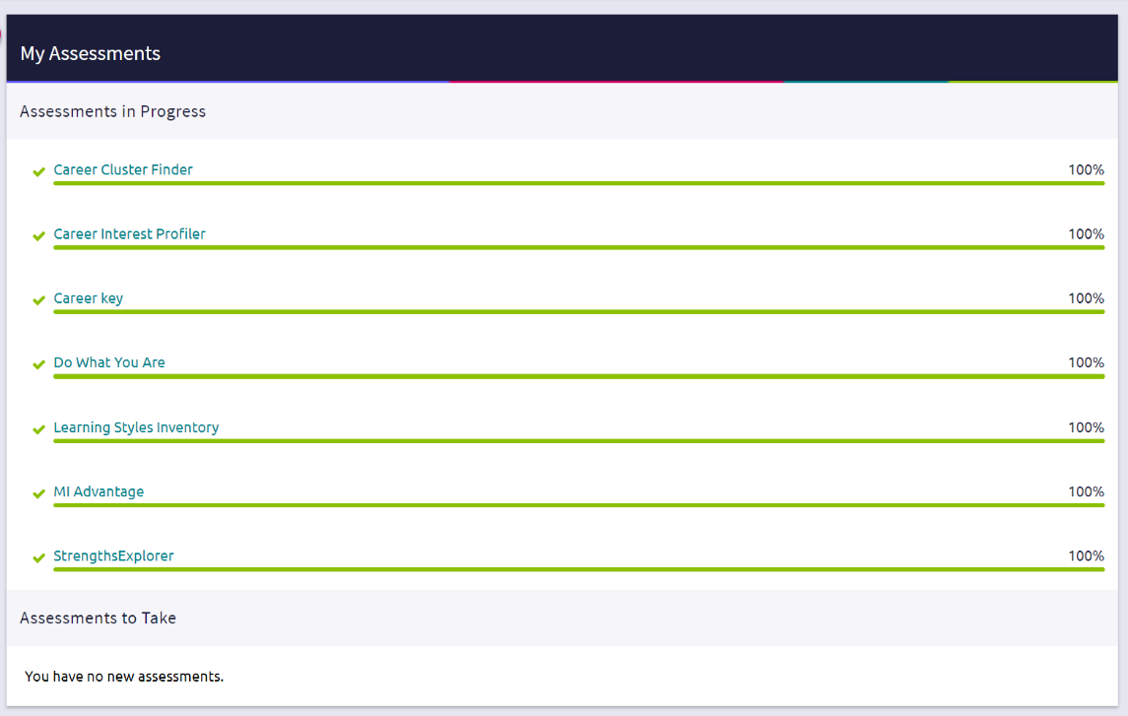
Assessment Progress Indicators
Quickly realize any assessments you have not taken or need to complete.

Slide 20
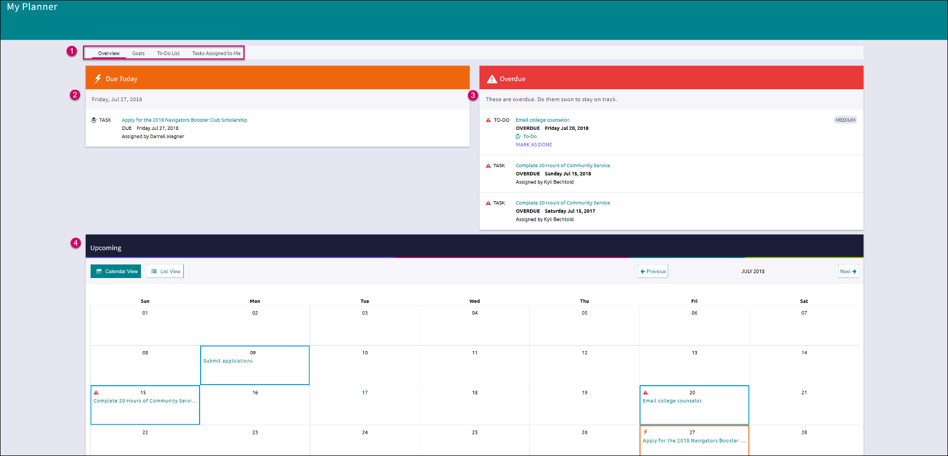
My Planner
Page
Planner Tabs: Quickly access, create and complete goals, to-dos, and tasks.
Due Today: View which tasks or to-do’s are up for completion on today’s date.
Overdue: View the to-do’s and tasks that are overdue and work to complete them.
Upcoming Calendar: See a calendar or list view of your upcoming month of tasks and to-do items.

Slide 21
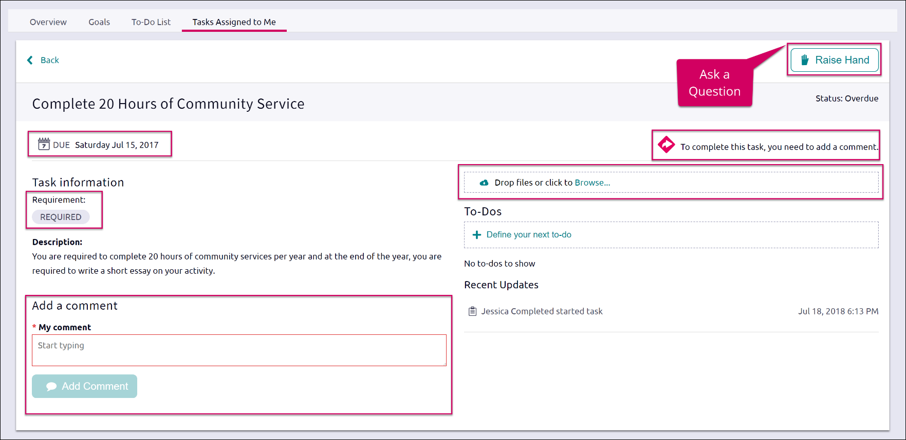
Easily View and Complete Tasks
Once viewing a task, find the due date, task requirement, comment section, area to ask a question, how to complete an assigned task, and add files, if needed. Some tasks will have a Completed button, if it can be completed manually.

Slide 22
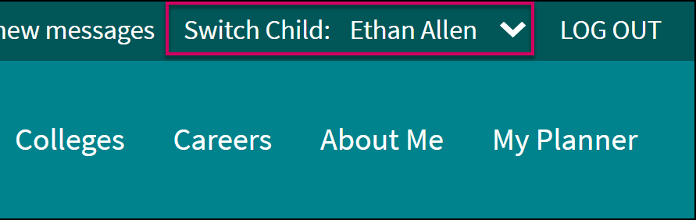
Parents, What do you Need to Know?
Log in using the same site URL as your student, simply use your own username/password combo.
When you log in, you will be able to view your students’ Naviance Student environment. Not all components will be active or visible.
If you have more than one student in a school, use the Switch Child drop-down to easily change the student you are viewing.
You can add comments to tasks and journals that are visible to you.
View results for assessments like StrengthFinder, Do What You Are, and others.

Slide 23
Get Started using Naviance Student Today!

Slide 24
Counselors, What Extras do you Need to Know?
While you cannot use “ghosting” as you know it, you can use View as Student to look at a student’s account AND you can use their student folder in Naviance to perform actions on their behalf.
Demo Naviance Student is like a sample student, but without all of the hassle of logging in and out. As soon as you use it, a demo account that belongs to YOU is created and can be used to play with Naviance Student.
A video showing the difference between Demo Naviance Student and View as Student is in the Naviance Network under the Video Lessons Library. This video also shows how to perform actions on behalf of a student from Naviance.
Naviance has provided reference guides and videos that are student and parent-facing, they can be found in the Naviance Network under the Naviance Student Library.
All of the content in Naviance is being updated to reflect the change from Family Connection to Naviance Student. This includes help materials in the Naviance Network.
.

